Slide 1
IDM CHALLENGE 2
BY MAAZ ADNAN 22763

Slide 2
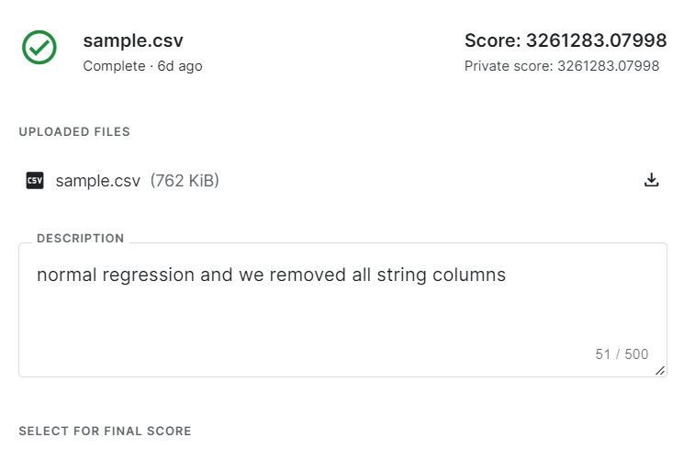
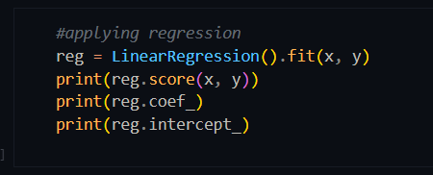
Linear Regression
Linear Regression by simply removing all string columns and using all other value columns

Slide 3
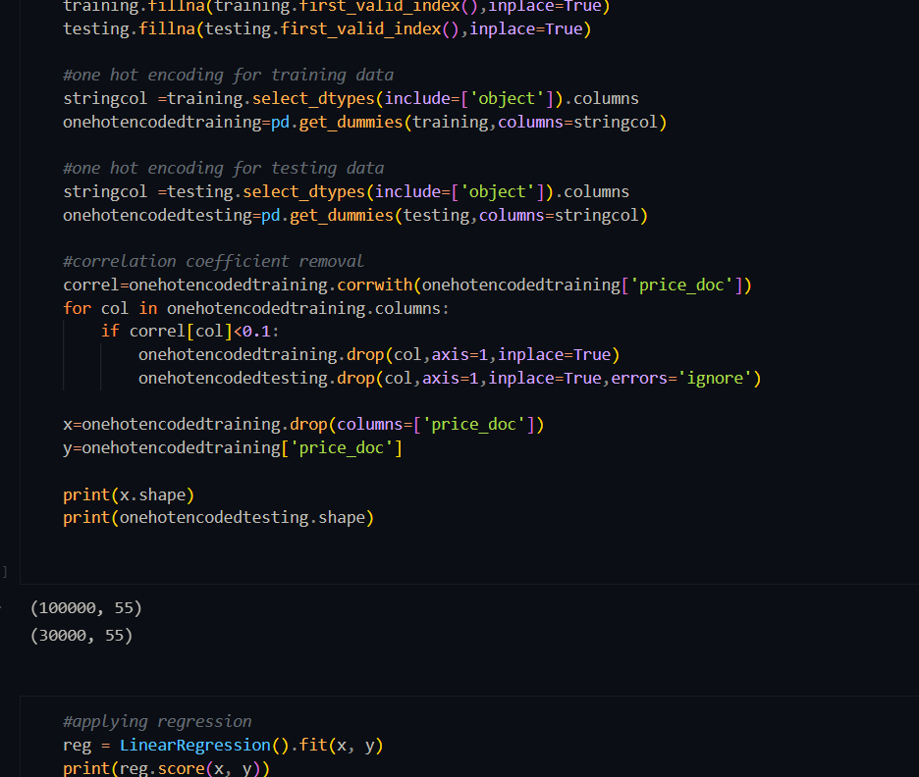
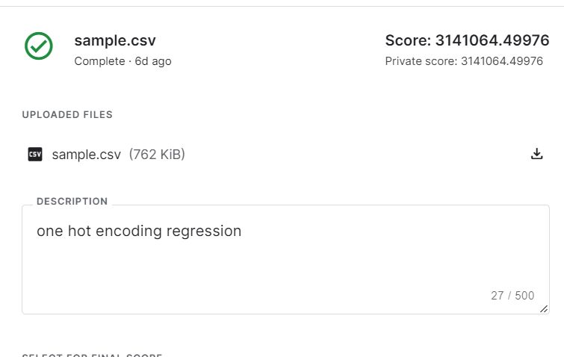
Linear Regression by simply using all columns and doing one hot encoding

Slide 4
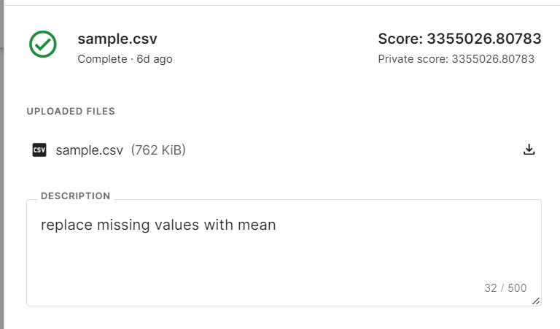
Linear Regression by doing one hot encoding and replacing missing values with mean

Slide 5
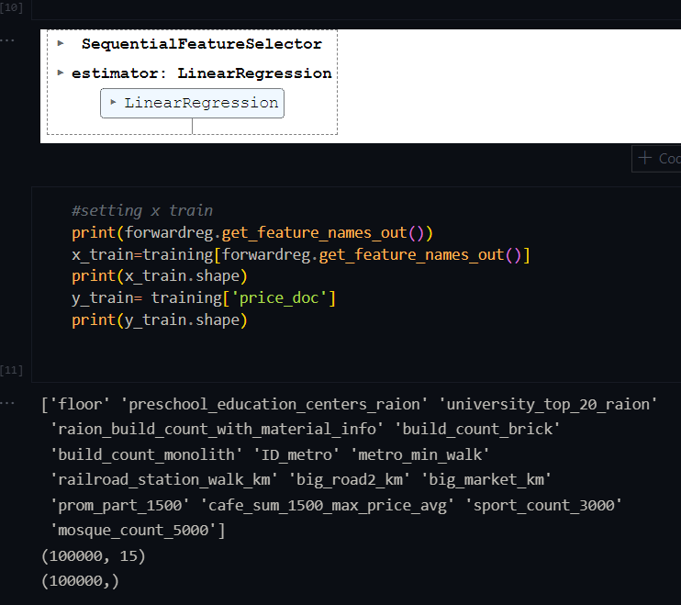
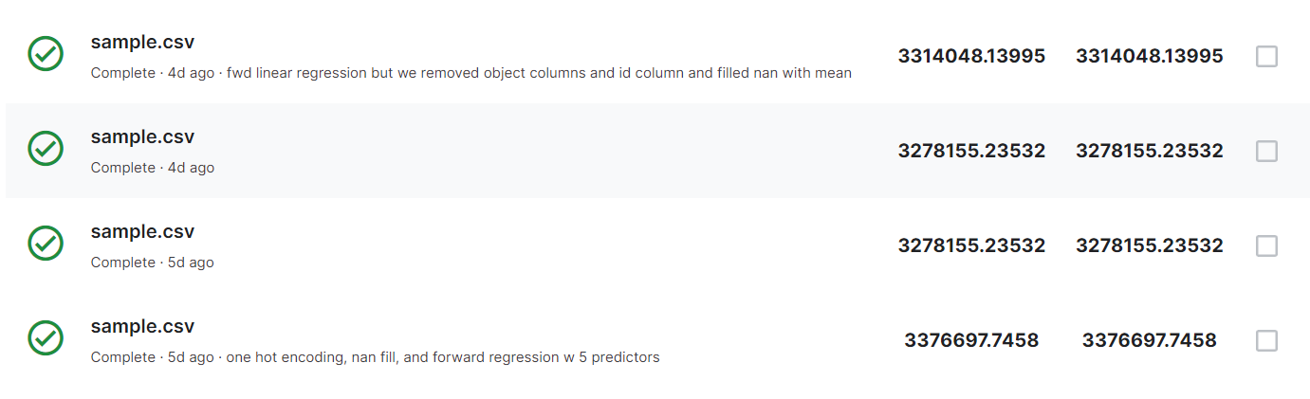
Linear Forward Regression by doing one hot encoding and replacing missing values with mean
Different values for feature selection were used for forward selection

Slide 6
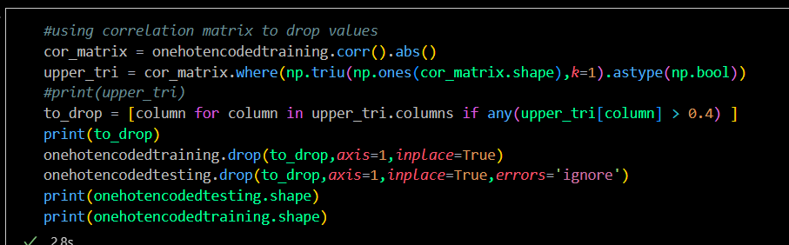
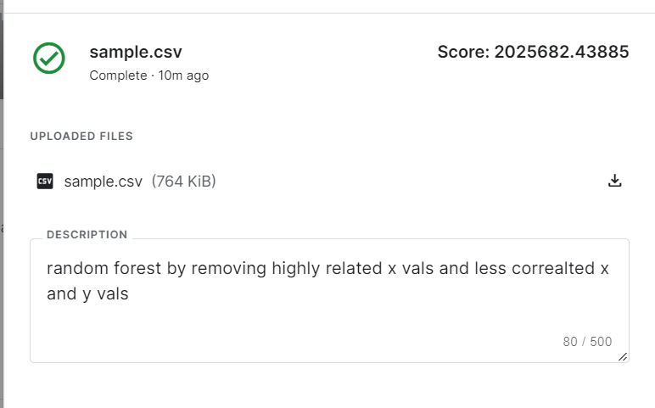
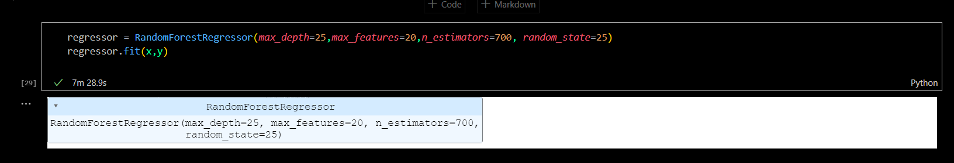
Random Forest Regressor
Random forest regression by dropping highly correlated columns in x, dropping cols not correlated with y and then using one hot encoding

Slide 7
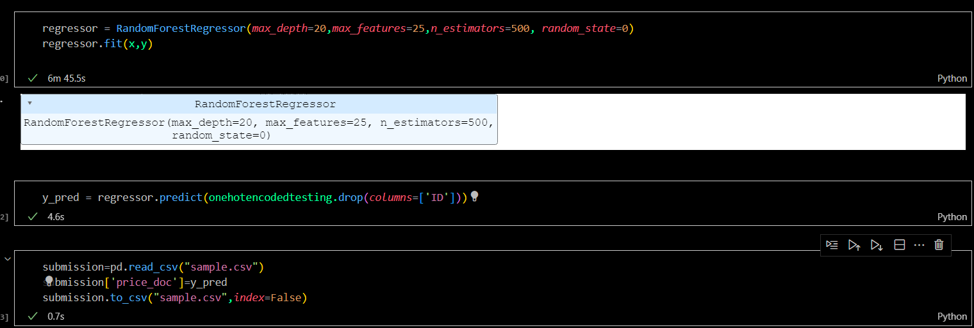
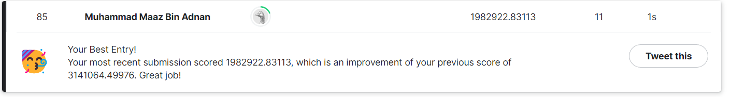
RANDOM FOREST REGRESSOR, WITH ONE HOT ENCODING OF STRING VARIABLES , SCORE =1982922.83113

Slide 8
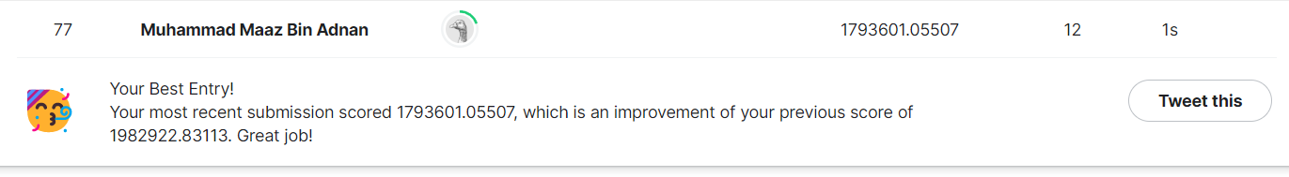
RANDOM FOREST REGRESSOR, WITH ONE HOT ENCODING OF STRING VARIABLES , SCORE =1793601.83113

Slide 9
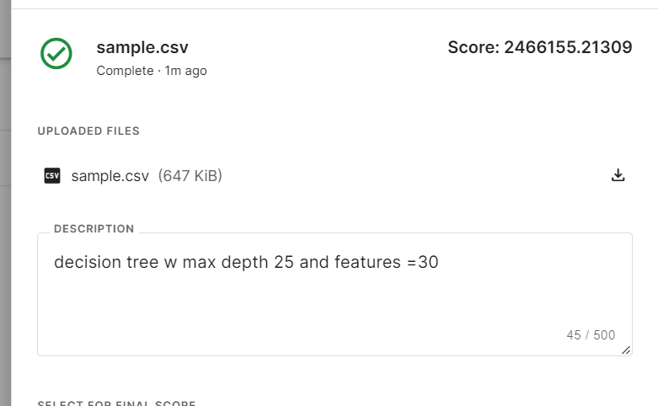
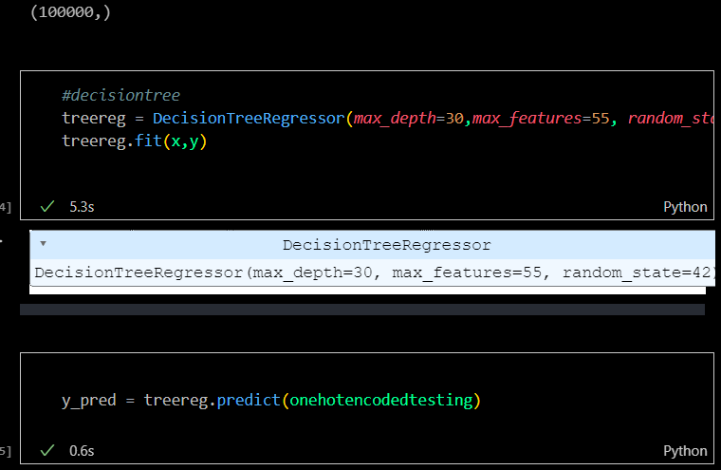
Decision Tree
Decision tree regression by dropping non correlated columns and then using one hot encoding

Slide 10
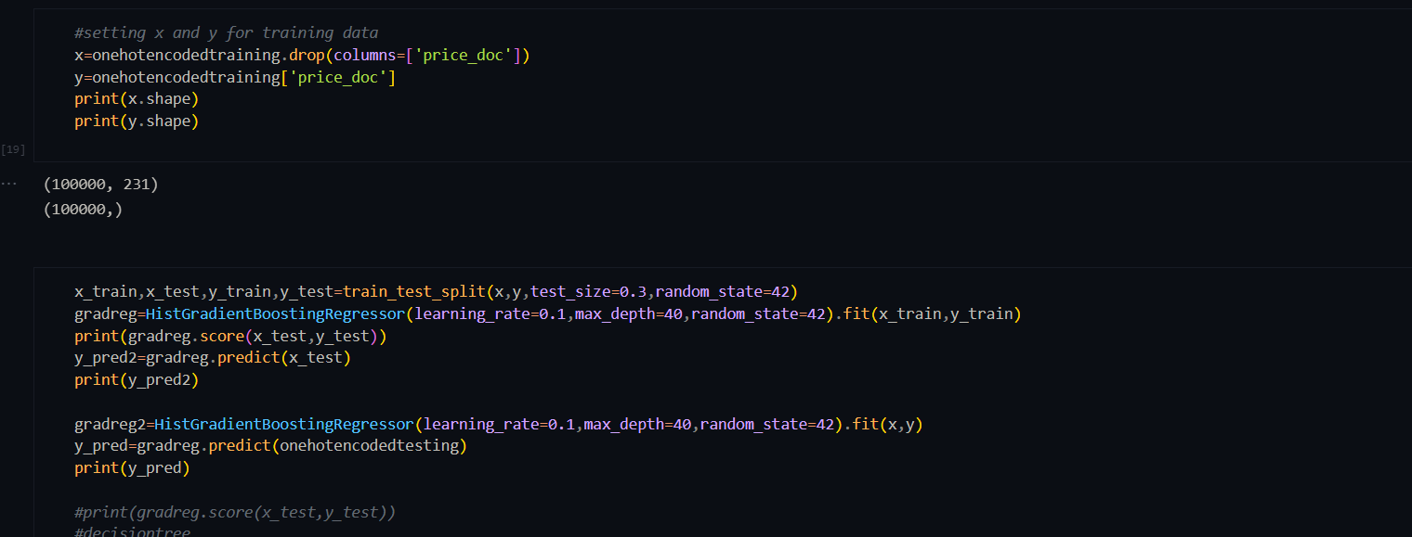
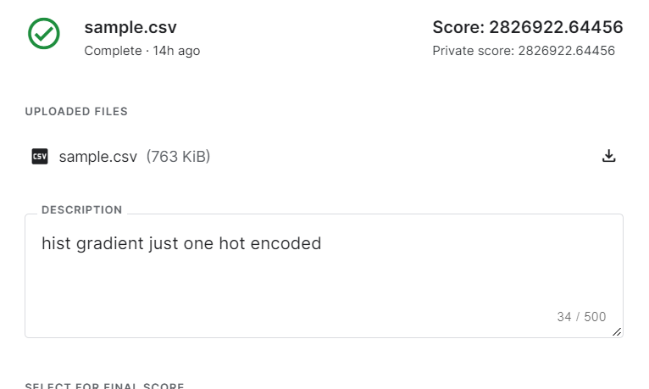
Gradient Boosting
Gradient boosting regressor using one hot encoding and dropping highly correlated x vals

Slide 11
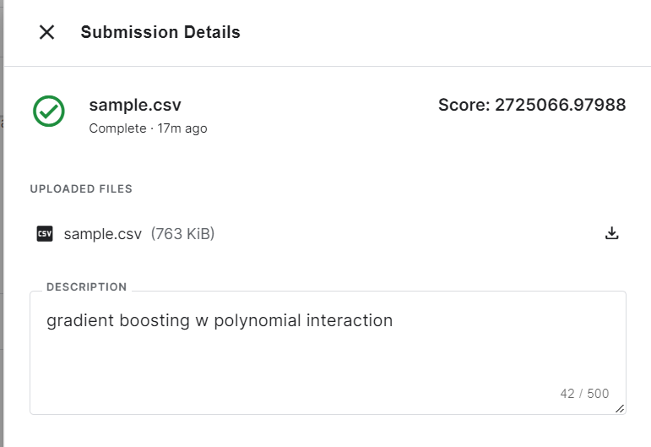
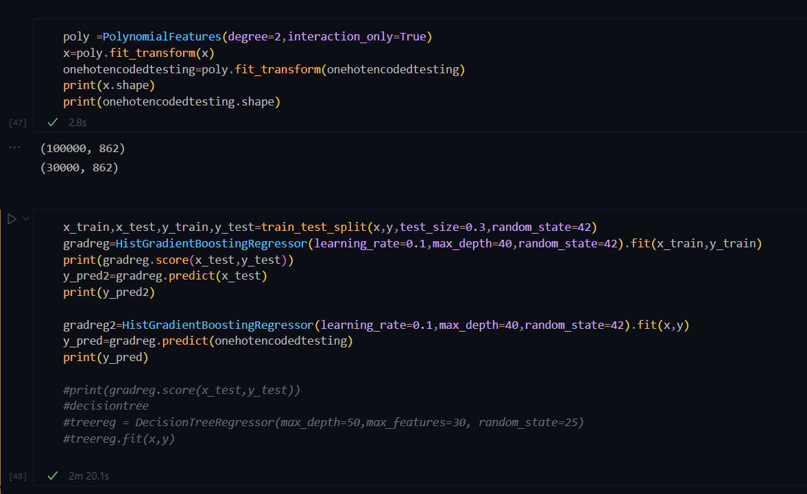
Gradient boosting regressor using polynomial interaction, dropping highly correlated x vals and one hot encoding

Slide 12
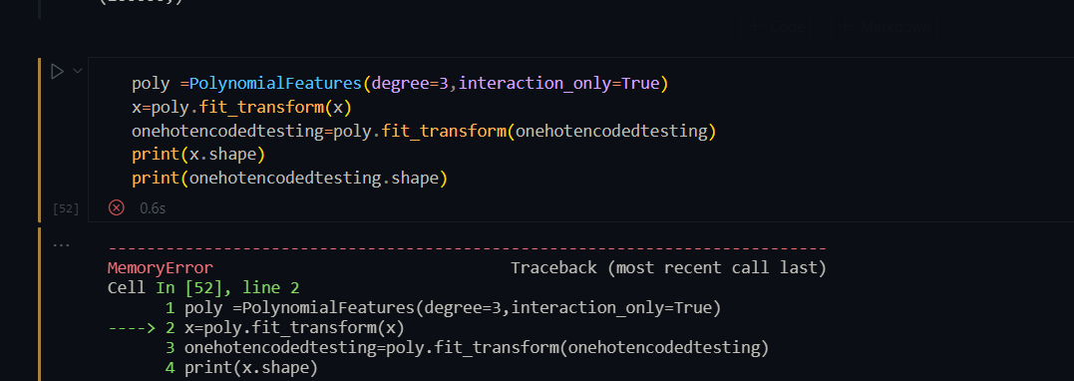
Memory error for any polynomial above 3

Slide 13
Memory error for backward regression also

